Slide 1
Lab 2
Data Structures and Dynamic Singly Linked Lists in C

Slide 2
What is a data structure?
A way of organizing memory

Slide 3
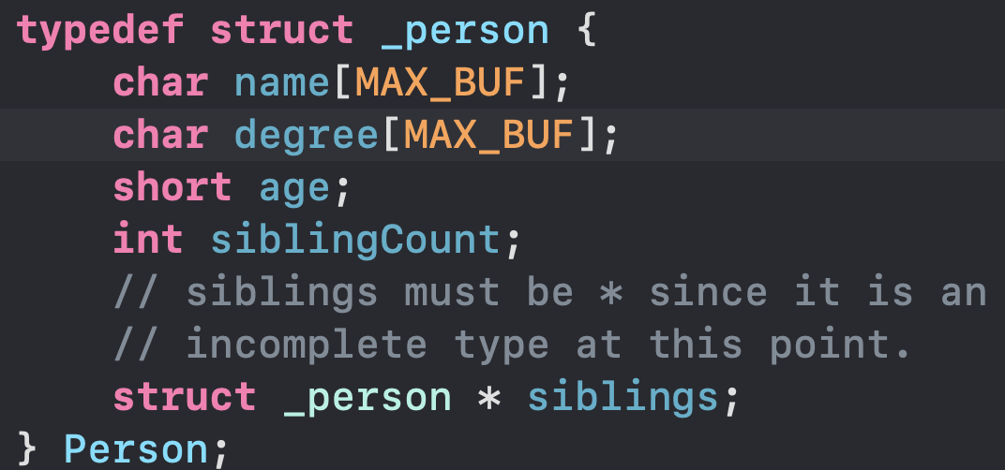
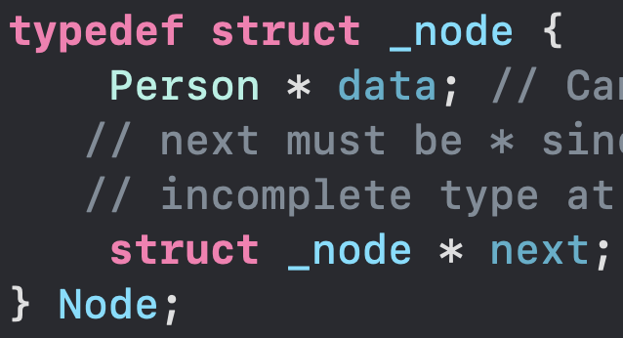
How to reference a struct within itself
Where do we put structures?
Header files

Slide 4
Ideal layout of files For all projects
Header = .h file; Source = .c file
1 header file for your structures
1 header/source file for your structure processing
Another one for output if you have many structures
Or a single header/source file for each structure – depends on specific circumstance
1 header/source file for your data processing
If there are a lot of different calculations which can be sectioned off, then it should be further broken down
1 header/source file for input/output
1 source file for main
7 files

Slide 5
Why do we want to break down files so much?
Code becomes more portable between projects
You copy files from project to project
You can continuously build upon your past work
It will encourage you to write modifiable and generic code
generic code will not always be an option

Slide 6
Questions?

Slide 7

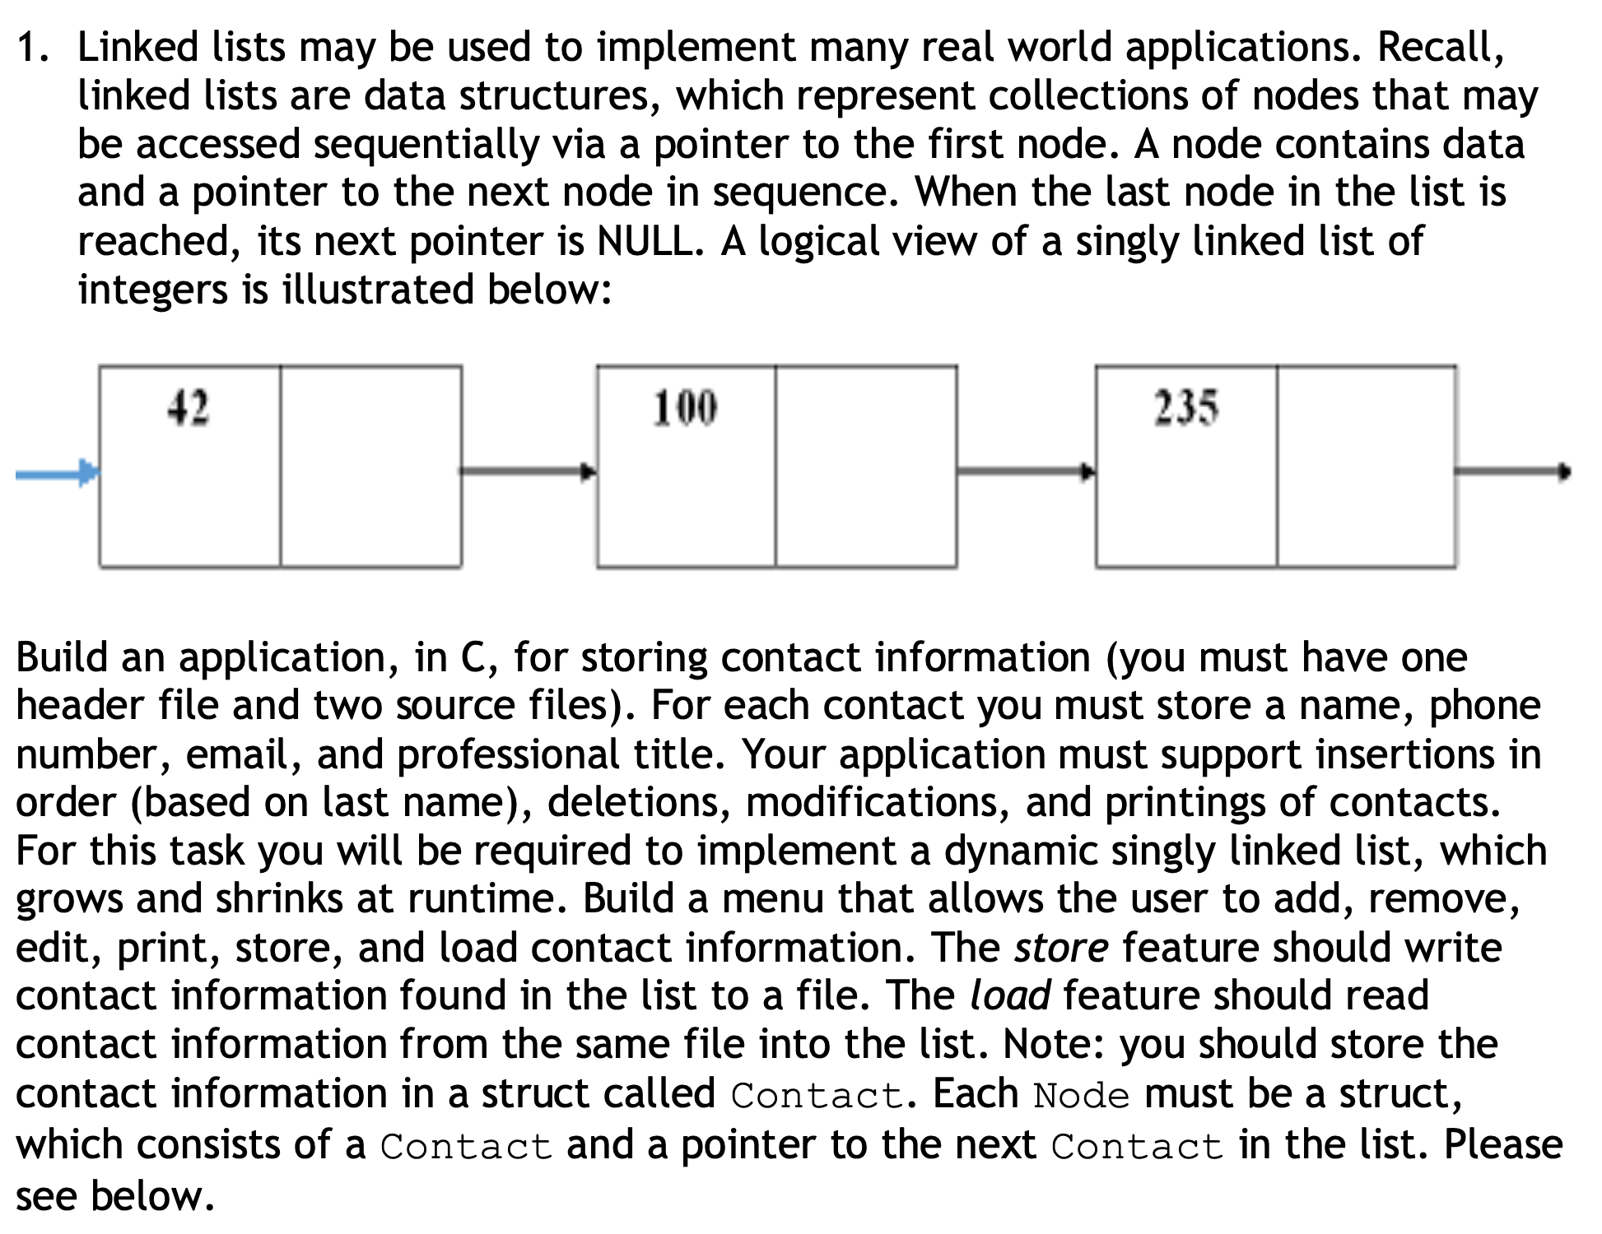

Problem 1 (main part)
There are function prototypes in the instructions
Copy/paste the structures and prototypes into your header file
Then work on printing the list
If you have finish problem 2, come back and do it in a for loop, while loop, and recursive function

Slide 8
Problem 2 Tests
Test functions accept a void param and return a void
Test functions are self-sustaining
If it accepts input or returns something, it is not proper
Only test a single part or function
i.e., only test structure creation. Not creation and insertion in the same test
Specifically,
A test should test the creation of a node and properly destroy it once it is created. If you have a destroy function, do not use it – only use your creation then manually destroy the node.

Slide 9
Note on tests: You will never test every possible input
You will never have a program that tests all possible cases because there are 2¹⁹² states!
A program with 1 int = 256 states!
x bits = x states
1 byte = 8 bits
1 int = 4 bytes
1 double = 8 bytes
Suppose we have a program with 2 ints and 2 double in total
(2 * 4) + (2 * 8) = 24 bytes ; 24 bytes = 192 bits
2¹⁹² = 6277101735386680763835789423207666416102355444464034512896 (58 decimal digits)
Thus, you would need to try 2¹⁹² combinations of values before you test all possible inputs.

Slide 10
how we want tests
Ideally, they will cover 100% of code and every scenario.
We strive for 100% code coverage, but again may not be able to
We will one test class per class (in C, per function)
You may want to split tests up when the class is too complicated
At this point, you may want to split up your class or redesign
We want design functions to be testable
Can we debug it?
Can we call it from outside? (Tricky problem, wait for CS321)
It is an algorithm (for some input I, do we ALWAYS get output O?)
If you answer no to this question, delete the function and start over (its not a function)

Slide 11
Edge Cases
Edge cases
Cases that should not affect many or any users
Look for cases where a value is on the edge and it could cause problems (i.e., num at max & min bounds)
Use the same part repeatedly (much more than what a typical user would)
Keep incrementing a value that may cause unexpected behavior with another variable
If you are working with networking, ensure you handle the rst signal correctly
Should it crash the program, trigger a reset of something, or simply ignore it?
Ex: A finance app that incorrectly rounds.
You lose 1 penny / day
=> You lose $3.65 per year ($28.52 million in WA would have been lost)
=> You have lost $182.5 after 50 years ($1,425.87 million in WA would have lost)

Slide 12
Exception Testing
Exception cases (Until C++, ignore)
You look for cases where an exception is thrown
You hope that it is either thrown or not thrown (depending on you needs)
Overall, we do not like exceptions since they cost a lot of clock cycles!
When you work with exceptions, you typically want to catch the error, then decide if you want to raise it again or not
When we throw it and keep raising it, we may not know where it came from

Slide 13
Normal Test cases
This is what we are doing today
Normal cases
You simply make sure the expected result occurs
If you have a function that adds two numbers, put in 1 and 2; make sure it equals 3
Some cases for today:
Ensure nodes are properly created
Ensure nodes are destroyed properly
Ensure nodes are inserted properly
Ensure nodes are removed properly

Slide 14
Questions?

